Slide 1
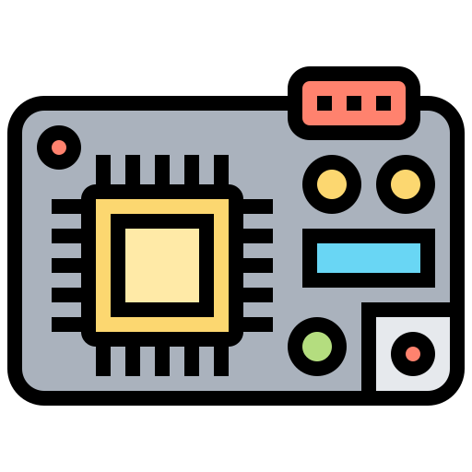
BA HTCS | BUILD-A-THON | PDLC WORKFLOW - DEFECT FIX CYCLE | SCOPE – CODING DEFECTS CFP < X
PRESENTATION TEMPLATE
Persona: Developer
Piloted Programs: VESDA
Tech stack: Embedded
Problem Statement
Fixing firmware bugs on MCU systems is slow because engineers must manually set up JTAG, decode fault registers, check datasheets, and switch between multiple tools like IDEs, oscilloscopes, and Jira.
Key knowledge—such as common Hard Fault causes and register details and its not well documented. As a result, resolving issues can take days, which delays releases.
Agentic AI Solution Workflow diagram
Bug/Story Ticket
JTAG Orchestrator
-Context Extraction -Tool / Agent Routing
A2A
Sub Agents (Multi-Agent)
Fault Analyzer
Variable Tracer
Peripheral Inspector
Probing
Agent
Controlled Auto Fix
Physical Interface to Hardware
Solution Description
Target MCU - Hardware
(STM32 , Cortex-M)
A multi-agent system attached to IDE (Orchestrator, Fault Analyzer, Variable Tracer, Peripheral Inspector, Hex/Memory Parser, Probing Agent) exposes Standard Debugging tool -level debugging as conversational actions over a CLI/daemon connected to J‑Link and the target MCU. The system can integrate with Jira to auto-triage, diagnose, generate code patches, create PRs, and attach trace/register evidence, moving tickets to review or blocked based on outcome.
Git Provider
- Branch + PR Creation
Jira Ticket
RCA | Logs | Review

